Slide 1
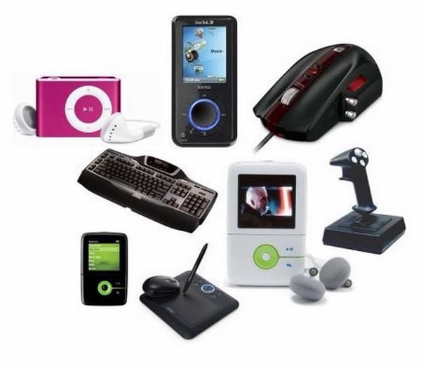
High tech gadgets

Slide 2
We are going to:
- learn new words: high tech gadgets and their uses
- read the text: profiles of people (matching)
- talk about your favourite gadgets

Slide 3
The use of modern gadgets.
You know that modern inventions are used in everyday life and make it easier.
What are gadgets?
Why does a modern man need them?
This is what we are going to speak about at our lesson.

Slide 4
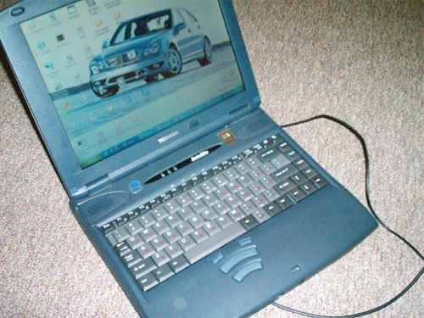
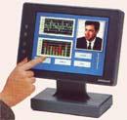
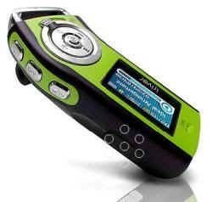
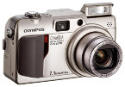
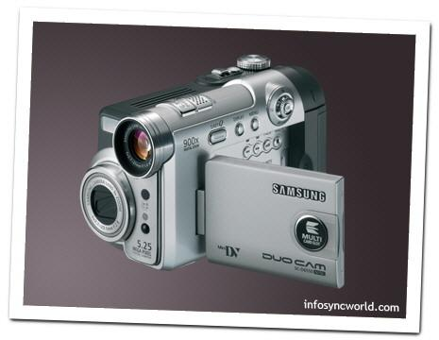

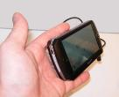


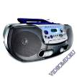
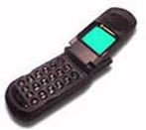

High Tech Gadgets
Look at the pictures. What are their names?

Slide 5
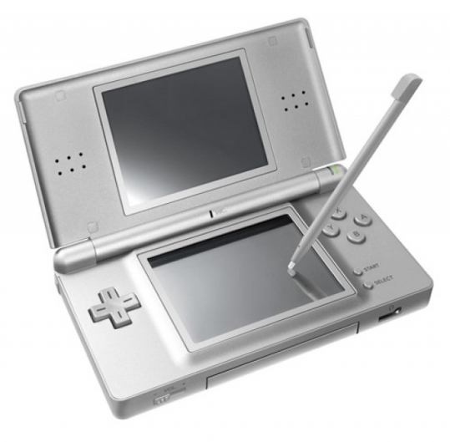
New words
gadget-техническая новинка
camcorder-видеокамера
device-прибор, механизм
digital-цифровой
techno freak-фанат техники
portable- переносной
laptop-ноутбук
headphones-наушники
software-программное обеспечение
equipment- оборудование
edit-редактировать
charge-заряжать (charge-заряд. устройство)
store information-хранить данные
up-to-date=modern -современный

Slide 6
Guess
A camcorder digitally records pictures and sound.
A laptop stores and deals with large amounts of information.
An MP3 player records and plays music downloaded from the Internet.
A video mobile phone makes and receives video phone calls.
A PDA organises and stores information such as telephone numbers, addresses, etc.
A digital camera takes and stores digital photographs.

Slide 7
A radio cassette player plays music from the radio or cassettes.
A Walkman® plays music through headphones, especially for use when travelling.
A dictaphone plays and records sounds, especially voices.
A TV broadcasts TV programmes with pictures and sounds.

Slide 8

Give the English equivalents:
техническая новинка,
видеокамера,
прибор, механизм,
цифровой,
фанат техники,
переносной,
ноутбук,
наушники,
программное обеспечение,
оборудование,
редактировать,
заряжать, заряд,
хранить
современный

Slide 9
Ex 1p 140 Complete the sentences, using the names of the gadgets and the words below:
I would use a … to …
record my lessons at school
tell the time
send a picture message to a friend
film a friend’s birthday party
listen to music
send emails
keep a record of my spending
watch a DVD
look up a friend’s address
edit my essay on the bus
do some Internet research for a project
show photos to my friends
burn songs onto a CD
listen to the news
plan my day/week
1 dictaphone
2 video mobile phone, PDA
3 video mobile phone
4 camcorder
5 laptop, MP3 player, radio cassette player,
Walkman®
6 laptop, PDA
7 laptop, PDA
8 laptop
9 PDA
10 laptop
11 laptop
12 laptop, digital camera, video mobile phone
13 laptop
14 video mobile phone, Walkman®, radio cassette player, TV
15 laptop, PDA

Slide 10
High Tech Gadgets
I have got ____ . I use _____ to __V__ .

Slide 11
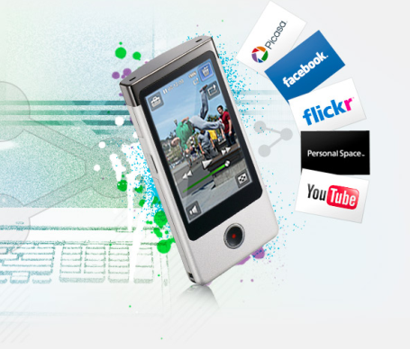
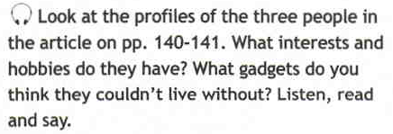

Ex.3a, p. 140 Reading
Sarah Tyson likes shopping and friends. I think she couldn’t live without her mobile phone.
Andy Cooper likes music and video games. I think he couldn’t live without his MP3 player and his computer.
Tina Appleby likes cinema and photography. I think she couldn’t live without her digital camera.

Slide 12


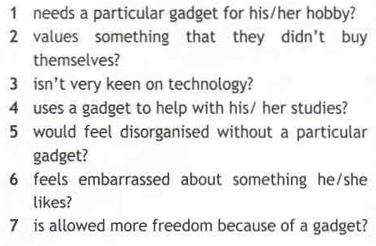
Ex.3a, p. 140
1 Tina
2 Andy
3 Sarah
4 Andy
5 Tina
6 Andy
7 Sarah

Slide 13
Ex 3b Identifying pronouns within a text
Sarah:
… couldn’t organise my life without it ― her mobile phone
… if I keep calling them ― her parents
Andy:
… good voice recorder on it ― his mobile phone
… listen to them ― university lectures
… ashamed to admit it ― the fact that he is hooked on his PlayStation 2®
… very keen on it ― his Playstation 2®
Tina:
… change documents on it ― her PDA
It keeps my whole life together ― her PDA
… lost without it ― her PDA
… when I visited them ― her clients
… edit them using software ― home movies
… It’s a great pastime ― making home movies

Slide 14

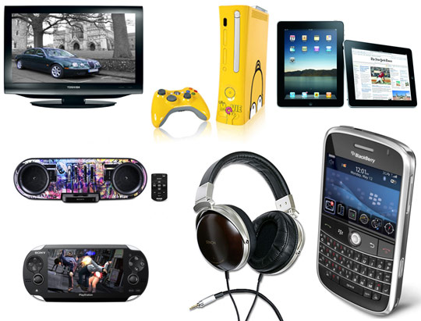
Ex 4 p 140 Identify the highlighted words throughout the text:
considering ― thinking about
handy ― convenient
hooked on ― addicted to
keen on ― interested in
on the move ― travelling
to the extent ― to the point
apart from ― other than
edit ― alter

Slide 15
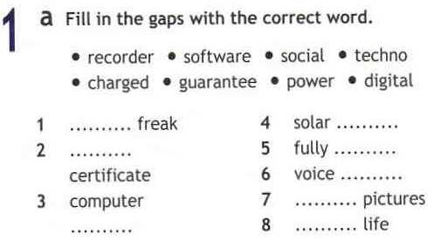
Home work.

Slide 16

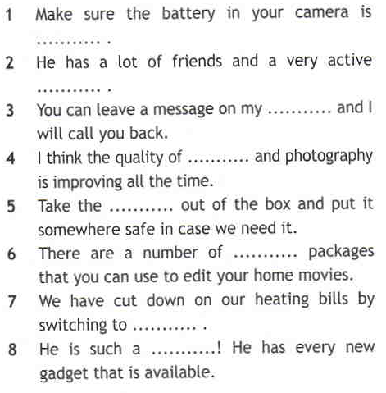

Slide 17
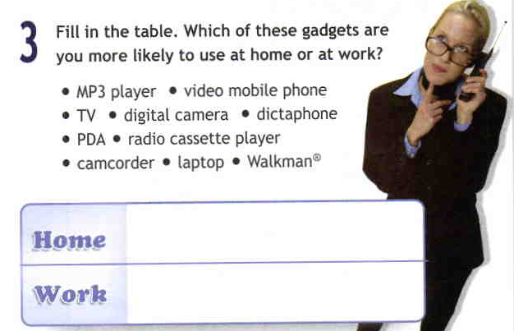
Ex 3

